Slide 1
Lecture 8 Web Development

Slide 2
Objectives
Web Development
HTML/ Basic HTML tags
Headings
Title
Paragraph
Tables
Forms
Images
Links
Lists
Buttons/Checkbox
Bold/Italic/Color
Comments
Text Box
Email/ Password

Slide 3



Front End

Slide 4

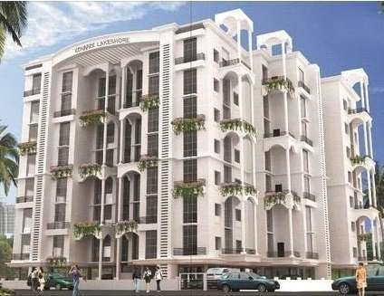

Three Layers of Web Design
Structure | Style | Behavior
HTML markup | CSS | JavaScript

Slide 5
Tags
Tags are enclosed in <angle brackets>
The closing tag has the forward slash </tag>
Tags can be upper or lower case
Historically lower case is used and is generally recommended

Slide 6
Attributed
Attributes add discretionary properties to tags
They are added to the opening tag within the <> brackets
For example <html lang=“us-en”> adds a language attribute to the <html> tag which is useful for search engines and assistive devices
Attributes can use single or double quotes – or no quotes
Best practice suggests always quote attributes – and stay consistent with style

Slide 7
Basic HTML Template
<html>
<head>
<title> HTML Template </title>
</head>
<body>
<h1> Main Heading Here </h1>
<p> Paragraph here. </p>
</body>
</html>
Copy this code into any text editor
Save it as first.html
(or give it any other name.html)
Double click the file to open it in your browser

Slide 8
Hello World!!
<html lang=“us-en”>
<head>
<title> Hello, World! </title>
</head>
<body>
<h1> Hello, World! </h1>
<p> My first HTML web page.</p>
</body>
</html>
Change the title and body text from the previous code
Add the language attribute
Add additional paragraph
Save it with different file name filename.html

Slide 9
Headings
<body>
<h1> This is Heading 1 </h1>
<h2> This is Heading 2 </h2>
<h3> This is Heading 3 </h3>
<h4> This is Heading 4 </h4>
<h5> This is Heading 5 </h5>
<h6> This is Heading 6 </h6>
</body>
There are six heading levels <h1> to <h6> each with a smaller font size
The levels represent a semantic hierarchy indicating the relative importance of each heading
<h1> to <h3> are most common
Formatting is the domain of CSS
Create a page with different heading levels to see the difference

Slide 10
Summary
Tags | Description
<html> | Tells the browser this is an HTML5 document
</html> | Delimits the HTML document
Lang=“en-us” | Adds the language attribute
<head> </head> | Delimits an area for information
<title> </title> | Creates a title in the browser title bar
<body></body> | Establishes the content to display
<h1></h1> | Declares a heading
<p> </p> | Declares a paragraph

Slide 11
Unordered Lists
<ul>
<li> Item </li>
<li> Item </li>
<li> Item </li>
</ul>
<ul> tags define a non-sequential bulleted list (an “unordered” list)
<li> tags define a list item within the unordered list

Slide 12
Ordered Lists
<ol>
<li> Item 1 </li>
<li> Item 2 </li>
<li> Item 3 </li>
</ol>
<ol> tags define a sequential numbered list (an “ordered” list)
<li> tags define a list item within the ordered list

Slide 13
Nested Lists
<ul>
<li> Item 1 </li>
<li> Item 2 </li>
<ol>
<li> Sub Item 1 </li>
<li> Sub Item 2 </li>
</ol>
<li> Item 3 </li>
</ul>
Nested lists create a list within a list
Copy the nested code opposite
Switch the ordered and unordered lists
Add the type attribute to each list

Slide 14
Anchor Tags-Hyperlinks
<a href="url"> Link Text </a>
Links are created using the anchor <a> </a> tags
The link address is specified in the href attribute
Link Text becomes the underlined link the user clicks on to activate the link

Slide 15
Anchor Tags-Hyperlinks
<a href=“http://www.google.com”> Google </a>
<a href=“first.html”>
My First Web Page </a>
<a href=“#top”> Top of Page </a>
Link to an external site
Add several external links to a page
Link to a local file
Create a list of the web pages you saved and add local links (menu)
Link to an internal page marker

Slide 16
Image Tag
<img
src=“image.jpg” alt=“describe image here”
width=“100” height=“100”
/>
<img> tags have no closing tag
Attributes can be written as a single line of text or with whitespace for added readability
The browser ignores whitespace
The src attribute is the image path
The alt attribute is for replacement
Include width and height for browser

Slide 17
Image as Links
<a href="http://www.website.com">
<img
src=“image.jpg” alt=“describe image here” width=“100” height=“100”
/>
</a>
Create a clickable image
Wrap an <img> tag inside an anchor <a> tag

Slide 18
Tables
►<table> tags define a data table
►<tr> tags define a row with line breaks
<table>
<tr>
<td> tags define a data cell, and display inline, horizontally, in a row
Copy this code to create a table with 2 rows with 3 columns
Add additional rows and columns
<td> | Row | 1 | Col | 1 | </td>
<td> | Row | 1 | Col | 2 | </td>
<td> | Row | 1 | Col | 3 | </td>
<td> Row 1 Col 4</td>
<td> Row 1 Col 5 </td>
</tr>
</table>

Slide 19
Table Headings
<table>
<tr>
<th> Col 1 Heading </th>
<th> Col 2 Heading </th>
<th> Col 3 Heading </th>
</tr>
<tr>
<th> tags are inline elements that can be used to define column headings
<th> tags replace <td> tags in the top row for column headings
The first <td> tag of create row labels
<td> | Row | 1 | Col | 1 | </td>
<td> | Row | 1 | Col | 2 | </td>
<td> | Row | 1 | Col | 3 | </td>
</tr>
</table>

Slide 20
Caption
<table>
<caption>
<p> Title Goes Here
<p> This table shows . . .
</caption>
...
</table>
The <caption> tag is a container for a table title and/or description
The <caption> tag must directly follow the <table> tag
Long captions can also be done with standard html tags placed before the table tag

Slide 21
Summary
Tags | Description
<table> </table> | <table> tag defines a table container
<tr> </tr> | <tr> tags define a table row
<td> </td> | <td> tags define a cell for table data
<th> </th> | <th> tags define a table heading
colspan=“2” | colspan attribute defines the number of columns a cell should span.
rowspan=“2” | rowspan attribute defines the number of rows a cell should span.
<caption> </caption> | <caption> provide for a title and brief description

Slide 22
Quotations
<blockquote>
Four score and seven years ago our fathers brought forth, upon this continent, a new nation, conceived in liberty, and dedicated to the proposition that all men are created equal.
</blockquote>
<q> tags are used for short inline quotes with quotation marks
He said, <q> I will return </q>
The <blockquote> tag is a block level element used for longer passages and displays with indented text

Slide 23
Line Break
<p>
Without line break tags <br> the browser would display <br>
this as one continuous paragraph.
</p>
Web browsers ignore whitespace
The <br> tag can be used to force a line break

Slide 24
Comments and Horizontal Rule
<!-- comment -->
<hr>
Add comments to html code where needed
The <hr> tag adds a horizontal rule as separator line across the screen

Slide 25
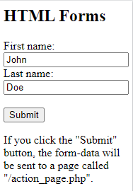
Forms
<h2>HTML Forms</h2>
<form action=“#top">
<label for="fname">First name:</label><br>
<input type="text" id="fname" name="fname" value="John"><br>
<label for="lname">Last name:</label><br>
<input type="text" id="lname" name="lname" value="Doe"><br><br>
<input type="submit" value="Submit">
</form>
<p>If you click the "Submit" button, the form-data will be sent to a page called "/action_page.php".</p>

Slide 26
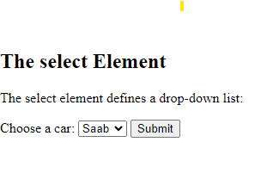
Select
<h2>The select Element</h2>
<p>The select element defines a drop-down list:</p>
<form action="/action_page.php">
<label for="cars">Choose a car:</label>
<select id="cars" name="cars">
<option value="volvo">Volvo</option>
<option value="saab">Saab</option>
<option value="fiat">Fiat</option>
<option value="audi">Audi</option>
</select>
<input type="submit">
</form>

Slide 27
HTML Tags
Tag | Description
<html> | Defines an HTML document
<title> | Defines a title for the document
<body> | Defines the document's body
<h1> to <h6> | Defines HTML headings
<p> | Defines a paragraph
<br> | Inserts a single line break
<a> | Defines a hyperlink
<!--...--> | Defines a comment
<strong> | Defines important text
<img> | Defines an image
<form> | Defines an HTML form for user input

Slide 28
HTML Tags
Tag | Description
<input> | Defines an input control
<textarea> | Defines a multiline input control (text area)
<button> | Defines a clickable button
<select> | Defines a drop-down list
<optgroup> | Defines a group of related options in a drop-down list
<option> | Defines an option in a drop-down list
<label> | Defines a label for an <input> element
<fieldset> | Groups related elements in a form

Slide 29
Text Formatting
CSS is the preferred way to change the browser’s display style
The separation of style and markup is a recommended best practice
However, there are some basic text formatting tags that can be used in HTML
These are inline tags used to mark text within the flow of another tag

Slide 30
CSS Linking Styles
Inline - by using the style attribute inside HTML elements
<h1 style=“color:blue;”> This is Heading </h1
<p style=“color:red;”> write a paragraph</p>
Internal - by using a <style> element in the html file
<html>
<head>
<style>
body {background-color: powderblue;}
h1 {color: blue;}
p {color: red;}
</style>
</head>
<body>
<h1>This is a heading</h1>
<p>This is a paragraph.</p>
</body>
</html>

Slide 31
CSS Linking Styles
CSS Linking styles
External - by using a <link> element to link to an external CSS file
<html>
<head>
<link rel= “stylesheet” href=“file.css”>
</head>
<body>
<h1>This is a heading </h1>
<p>This is a paragraph. </p>
</body>
</html>

Slide 32
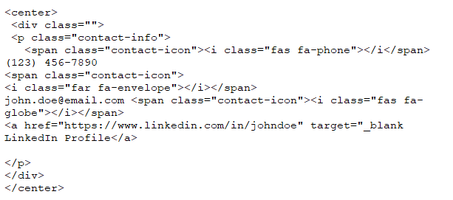
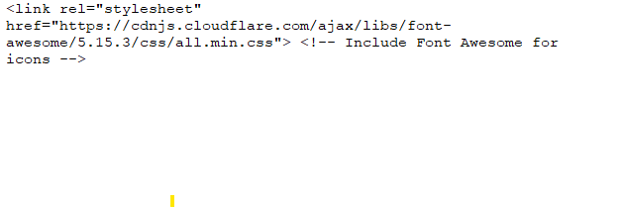
Some Examples of solving HTMl

Slide 33
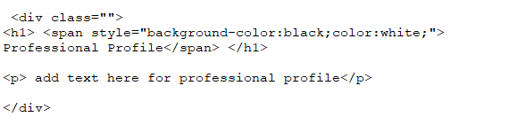
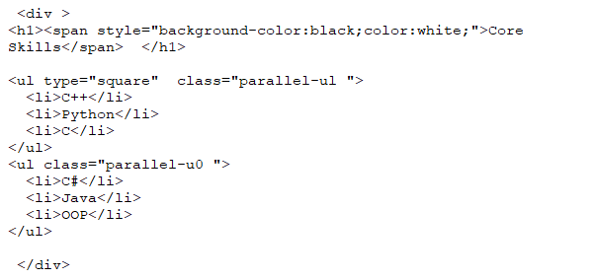
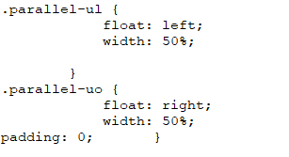

Slide 34
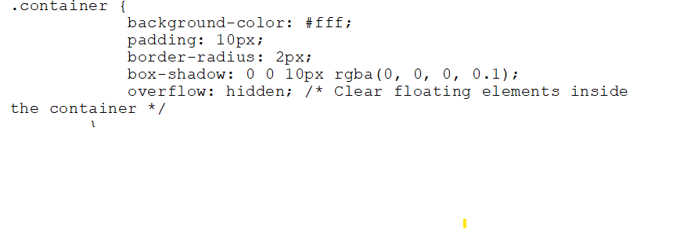
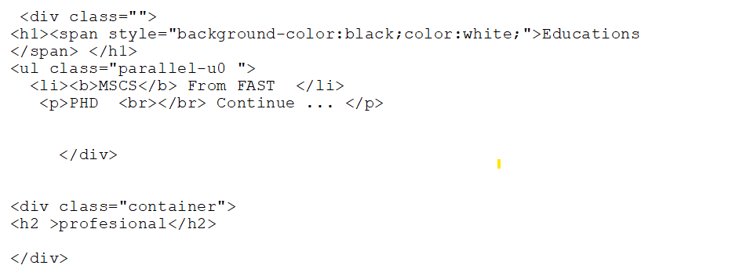
Some Examples of solving HTMl

Slide 35
Link Of Udemy Course
You are required to cover first three sections of this course
You have to implement all the content covered in the videos
Deadline→ Sunday 11:59pm
Note that Viva will also be conducted
Link: https://www.udemy.com/course/design-and-develop-a-killer-website-with-html5-and-css3/?couponCode=ST8MT101424

